Slide 1
Outline
n Importance of Project Risk Management
n Common Sources of Risk on IT Projects
n Seven Main Processes
1. Planning Risk Management
2. Identifying Risk
3. Performing Qualitative Risk Analysis
4. Performing Quantitative Risk Analysis
5. Planning Risk Responses
6. Implementing Risk Responses
7. Monitoring Risks
n Using Software to Assist in Project Risk Management
2

Slide 2


Opening Case
Cliff Branch was the president of a small IT consulting firm that specialized in developing Internet and mobile applications and providing full-service support. The staff consisted of programmers,
business analysts, database specialists, Web designers, project managers, and others. The firm had 50 full-time people and planned to hire at least 10 more in the next year. The firm also planned to increase the number of part-time consultants it used. The company had done very well during the past few years, but it was recently having difficulty winning contracts. Spending time and
resources to respond to various requests for proposals (RFPs) from prospective clients was
becoming expensive. Many clients were starting to require presentations and even some prototype development before awarding a contract.
Cliff knew he had an aggressive approach to risk and liked to bid on the projects with the highest payoff. He did not use a systematic approach to evaluate the risks involved in various projects
before bidding on them. He focused on the profit potentials and on how challenging the projects
were. His strategy was now causing problems for the company because it was investing heavily in the preparation of proposals yet winning few contracts. Several employees who were not currently working on projects were still on the payroll, and some of their part-time consultants were actively pursuing other opportunities because they were being underutilized.
What could Cliff and his company do to better understand project risks? Should Cliff adjust his
strategy for deciding what projects to pursue? How?
3

Slide 3



Importance of Project Risk Management
(1 of 7)
n Project risk management is the art and science of identifying, analyzing, and responding to risk throughout the project life and in the best interests of meeting project objectives
n Risk management is often overlooked in P.M. but can help improve the ultimate success of projects
Have a positive impact on selecting projects, determining their scope, and developing realistic schedules and cost estimates.
Help project stakeholders understand the nature of the project, involve team members in defining strengths and weaknesses, and help integrate the other P.M. knowledge areas.
n Good risk management often goes unnoticed, because it results in fewer problems and more expeditious resolutions
May be difficult for outsiders to tell whether the project success was due to risk management or luck, but project teams know that their projects worked out better because of good risk management.
4

Slide 4



Importance of Project Risk Management
(2 of 7)
n Risk versus crisis management
Crisis indicates an obvious danger to the success of a project, which receives the intense interest of the entire project team
Resolving a crisis has much greater visibility, often accompanied by rewards from management, than successful risk management.
n Managing project risks takes dedicated, talented professionals
PMI introduced the PMI Risk Management Professional (PMI-RMP®) certification in 2008
n All industries, especially the software development industry, tend to underestimate the importance of project risk management
Survey studies show that risk management has the lowest maturity rating of all knowledge areas
5

Slide 5
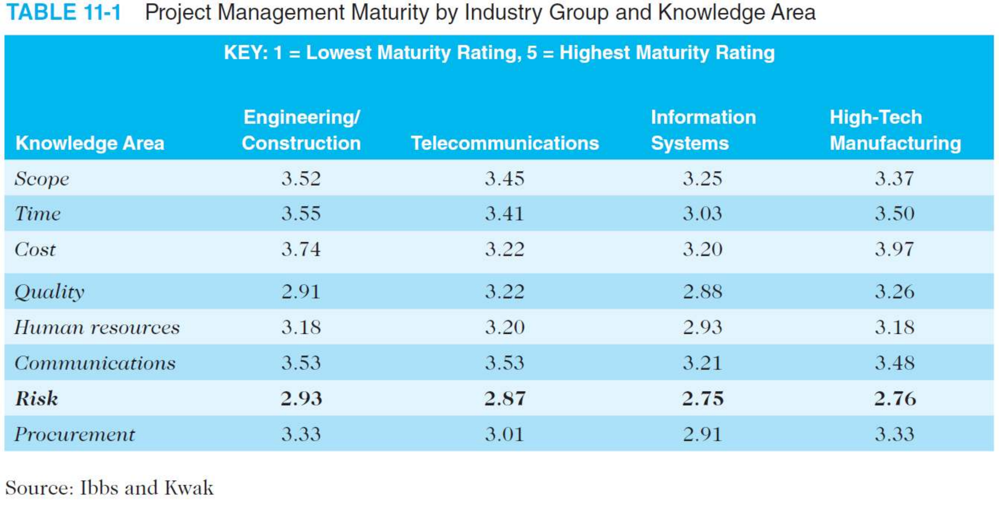
Importance of Project Risk Management
(3 of 7)
6

Slide 6
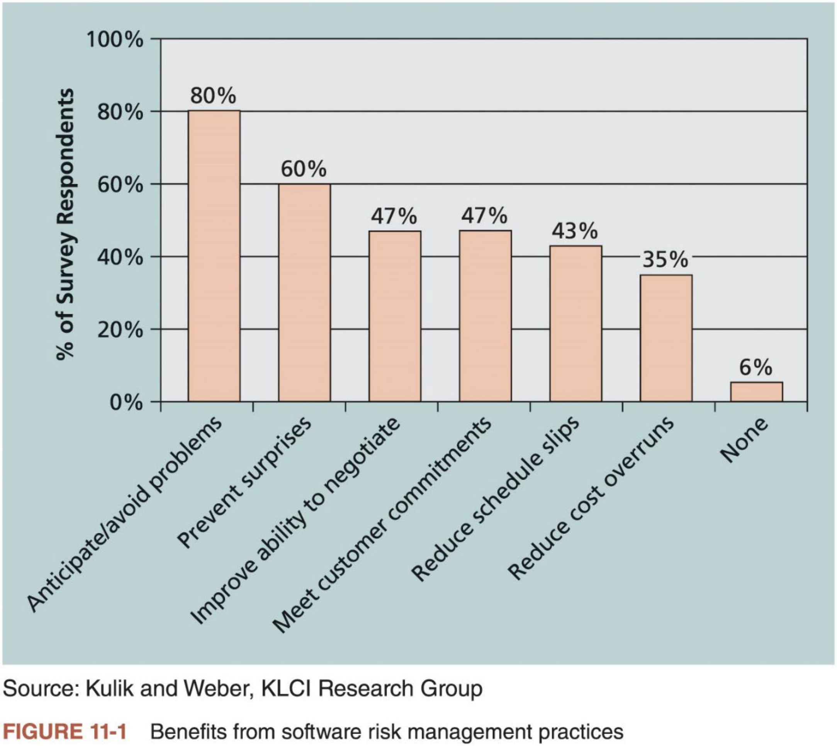
Importance of Project Risk Management
(4 of 7)
7

Slide 7


Importance of Project Risk Management
(5 of 7)
n What is a project risk?
An uncertainty that can have a negative or positive effect on meeting project objectives (PMBOK® Guide)
n Project risk management aims to avoid or mitigate negative risks (threats) while exploiting or enhancing positive risks (opportunities)
Managing negative risks involves possible actions that project managers can take to avoid, lessen, change, or accept the potential effects of risks on their projects
Managing positive risks is like investing in opportunities
n Project risk management can be viewed as an investment
How much an organization is willing to invest in risk management depends on the nature of the project, the experience of the project team, and the
constraints imposed on both.
The cost for risk management should NOT exceed its potential benefit.
8

Slide 8

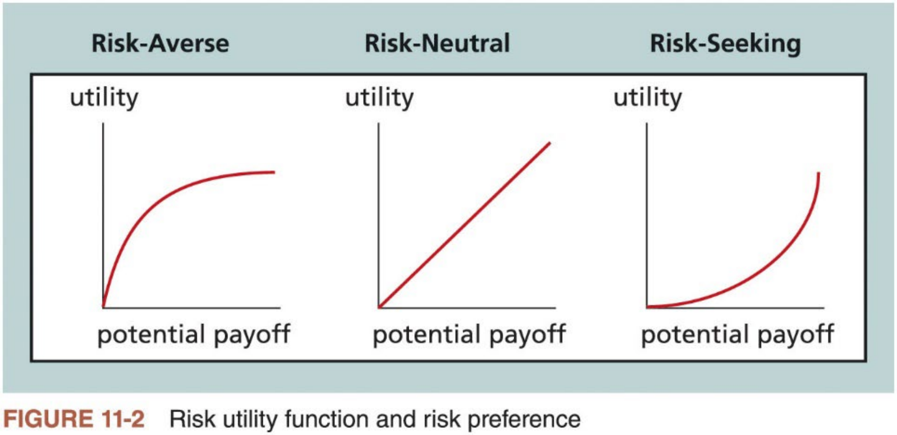
Importance of Project Risk Management
(6 of 7)
n Different organizations and people have different attitudes toward risk
n Three basic risk attitudes
Risk averse: a risk-averse person or organization has a low tolerance for risk.
Risk seeking: a risk-seeking person or organization prefers outcomes that are more uncertain and is often willing to pay a penalty to take risks.
Risk neutral: a risk-neutral person or organization achieves a balance between risk and payoff.
9

Slide 9
Importance of Project Risk Management (7 of 7)
n Seven main processes of project risk management
1. Plan risk management: decide how to approach and plan the risk management activities for the project
2. Identify risks: determine which risks are likely to affect a project and document the characteristics of each risk
3. Perform qualitative risk analysis: prioritize risks based on their probability and impact of occurrence
4. Perform quantitative risk analysis: quantitatively estimate the effects of risks on project objectives
5. Plan risk responses: take steps to enhance opportunities and reduce threats to meeting project objectives
6. Implement risk responses: implement the risk response plans
7. Monitor risk: monitor identified and residual risks, identify new risks, carry out risk response plans, and evaluate the effectiveness of risk strategies
throughout the life of the project
10

Slide 10
1. Planning Risk Management (1 of 3)
n Decide how to approach and plan the risk management activities for the project
Main output: risk management plan (R.M.P.) which documents the procedures for managing risk throughout a project
n To create an R.M.P., the project team should review project documents, corporate risk management policies, risk categories, lessons-learned
reports from past projects, and templates
Important to review the risk attitudes or tolerances (e.g., risk-averse or risk- seeking) of various stakeholders
n An R.M.P. summarizes how risk management will be performed on a particular project
Table 11-2 lists the general topics an R.M.P. should address
The level of detail of an R.M.P. depends on the needs of the project
11

Slide 11
1. Plan Risk Management (2 of 3)
Topic | Questions to Answer
Methodology | How will risk management be performed on this project? What tools and data sources are available and applicable?
Roles and responsibilities | Which people are responsible for implementing specific tasks and providing deliverables related to risk management?
Budget and schedule | What are the estimated costs and schedules for performing risk-related activities?
Risk categories | What are the main categories of risks that should be addressed on this project? Is there a risk breakdown structure for the project? (See the information on risk breakdown structures.)
Risk probability and impact | How will the probabilities and impacts of risk items be assessed? What scoring and interpretation methods will be used for the qualitative and quantitative analysis of risks? How will the probability and impact matrix be developed?
Revised stakeholders’ tolerances | Have stakeholders’ tolerances for risk changed? How will those changes affect the project?
Tracking | How will the team track risk management activities? How will lessons learned be documented and shared? How will risk management processes be audited?
Risk documentation | What reporting formats and processes will be used for risk management activities?
Table 11-2 Topics addressed in a risk management plan
12

Slide 12
1. Plan Risk Management (3 of 3)
n Many projects include contingency plans,fallback plans, and reserves to proactively manage project risks
i. Contingency plans: predefined actions the project team will take ifan identified risk event occurs.
ii. Fallback plans: developed for risks that have a high impact on the project and put into effect if attempts to reduce the risk are not effective.
iii. Contingency reserves: funds included in the cost baseline that can be used to mitigate cost or schedule overruns if known risks occur.
iv. Management reserves: funds held for unknown risks used for management control purposes. NOT part of the cost baseline, but part of the project
budget and funding requirements.
n Before managing the risk on IT project, it is important to recognize and understand the common sources of the risk
13

Slide 13
Common Sources of Risk on IT Projects (1 of 3)
n The Standish Group developed an IT success potential scoring sheet based on potential risks (refer to Table 1-2 in Lecture 1)
Ifa potential project does not receive minimum scores on certain success factors, then the organization might decide not to work on it.
n Many organizations develop risk questionnaires, which might include five broad categories of risks (refer to textbook for details)
i. Market risk
ii. Financial risk
iii. Technology risk
iv. People risk
v. Structure/process risk
n Useful to review the WBS for a project to see if there might be specific risks by WBS categories
14

Slide 14
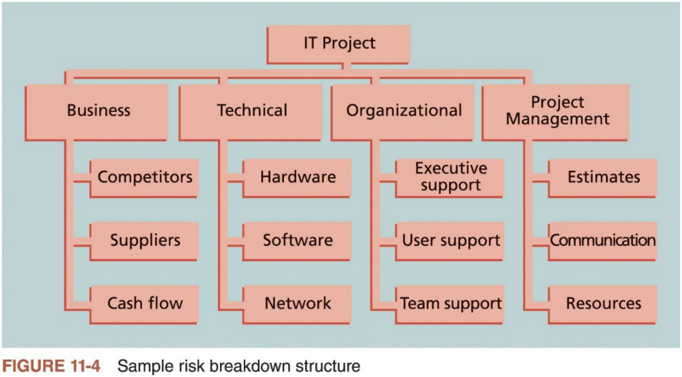
Common Sources of Risk on IT Projects
(2 of 3)
n Risk breakdown structure is a tool to help project managers consider potential risks in different categories
A hierarchy of potential risk categories for a project
15

Slide 15
Common Sources of Risk on IT Projects (3 of 3)
n Besides the nature of the project or products created, it is important to identify potential risks according to ten P.M. knowledge areas
Knowledge Area | Risk Conditions
Integration | Inadequate planning; poor resource allocation; poor integration management; lack of post-project review
Scope | Poor definition of scope or work packages; incomplete definition
Time | Errors in estimating time or resource availability; errors in determining the critical path; poor allocation and management of float; early release of competitive products
Cost | Estimating errors; inadequate productivity, cost, change, or contingency
Quality | Poor attitude toward quality; substandard design, materials, and workmanship; inadequate quality assurance program
Human resource | Poor conflict management; poor project organization and definition of responsibilities; absence of leadership
Communications | Carelessness in planning or communicating
Risk | Ignoring risk; unclear analysis of risk; poor insurance management
Procurement | Unenforceable conditions or contract clauses; adversarial relations
Stakeholders | Lack of consultation with key stakeholder; poor sponsor engagement
Table 11-3 Potential negative risk conditions associated with each knowledge area
16

Slide 16

2. Identify Risks
n Understand what potential events might hurt or enhance a particular project
Important to identify potential risks early, but also important to continue to identify risks based on the changing project environment.
n Another consideration is the likelihood of advanced discovery
Often viewed at a program level rather than at a project level
For IT programs, advanced discovery could involve monitoring an important supplier who might remove support for software used on several projects.
n Common techniques for risk identification
1. Brainstorming
2. Delphi technique
3. Interviewing
4. Root cause analysis
5. SWOT analysis
17

Slide 17



Brainstorming
n Brainstorming is a technique by which a group attempts to generate ideas or find a solution for a specific problem by amassing ideas spontaneously and without judgment
It can help the group create a comprehensive list of risks to address later during qualitative and quantitative risk analysis
An experienced facilitator should run a brainstorming session and introduce new categories of potential risks to keep the ideas flowing. After the ideas
are collected, the facilitator can group and categorize the ideas to make them more manageable.
n Careful NOT to overuse or misuse brainstorming
Individual people working alone produce more ideas than they do through brainstorming in small, face-to-face groups.
Group effects such as fear of social disapproval and the effects of authority hierarchy often prevent idea generation for many participants.
18

Slide 18

Delphi Technique
n Delphi technique is systematic, interactive forecasting procedure based on independent and anonymous input regarding future events
An information-gathering approach that helps prevent some of the negative group effects found in brainstorming
Used to derive a consensus among a panel of experts who make predictions about future development
Use several rounds of questioning and written responses, including feedback to responses in earlier round, and take advantage of group input while
avoiding possible biasing effects of oral panel deliberations
For example, Cliff from the Opening Case could use the Delphi technique to help him understand why his company is no longer winning many contracts. Cliff could assemble a panel of people with knowledge in his business area. Each expert would answer questions related to Cliff’s situation. Then Cliff or a facilitator would evaluate their responses, together with opinions and justifications, and provide that feedback to each expert in the next iteration. Cliff would continue this process until the group responses converge to a specific solution. If the responses diverge, the facilitator needs to determine if there is a problem with the process.
19

Slide 19

Other Techniques
n Interviewing is a fact-finding technique for collecting information in face-to-face, phone, e-mail, or virtual discussions
Interviewing people with similar project experience is an important tool for identifying potential risks.
Important to be well-prepared for leading interviews. It often helps to create a list of questions to use as a guide during the interview.
n Root cause analysis identifies the root cause of a problem or opportunity (refer to cause-and-effect diagrams in Lecture 6)
Often result in identifying more potential risks for a project
n SWOT analysis can also be used during risk identification
SWOT stands for Strengths, Weaknesses, Opportunities, and Threats (also refer to Lecture 2)
Applying SWOT to a potential project can help identify the broad risks and opportunities to that project
20

Slide 20
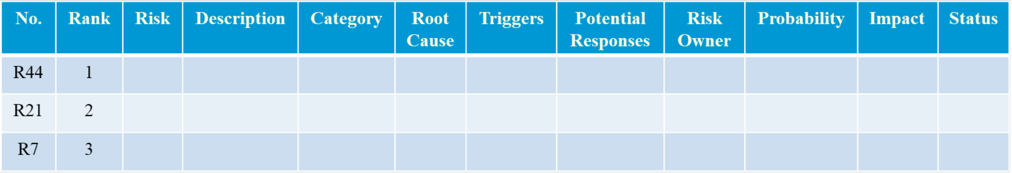
Risk Register (1 of 3)
n A document containing the results of various risk management processes, often displayed in a table or spreadsheet
A tool for documenting potential risk events and related information
n Risk events refer to specific, uncertain events that may occur to hurt or enhance the project
Negative risk events might include delays in schedule, cost overrun, supply shortages; while positive risk events might include completing work sooner or cheaper than planned, good publicity resulting from the project.
n Table 11-4 provides a sample of the format for a risk register
Table 11-4 Sample risk register
21

Slide 21
Risk Register (2 of 3)
n Elements ofa risk register
i. An identification number for each risk event
ii. Rank for each risk event: a number with 1 representing the highest risk
iii. Name and description of each risk event
iv. Category under which each risk event falls
v. Root cause of each risk
vi. Triggers for each risk: triggers are indicators or symptoms of actual risk events. Documenting potential risk symptoms for projects also helps the project team identify more potential risk events.
vii. Potential responses to each risk
viii. Risk owner or person who will own or take responsibility for each risk
ix. Probability and impact of each risk occurring
x. Status of each risk: Did the risk event occur? Was the response strategy completed? Is the risk no longer relevant to the project?
22

Slide 22








Risk Register (3 of 3)
n A sample entry in the risk register
No & Rank & Name: R44 & 1 & New customer
Description: We have never done a project for this organization before and don’t
know too much about them. One of our company’s strengths is building good
customer relationships, which often leads to further projects with that customer. We might have trouble working with this customer because they are new to us.
Category: People risk
Root cause: We won a contract to work on a project without really getting to know the customer.
Triggers: The new customer asked a lot of questions in person and via e-mail that
our existing customers would not, so we could easily misunderstand their needs and expectations.
Potential responses: Make sure the project manager is sensitive to the fact that this is a new customer and takes the time to understand them. Have the project manager set up a meeting to get to know the customer and clarify their expectations. Have Cliff attend the meeting, too.
Risk owner: Project manager
Probability & Impact: Medium & High
Status: Project manager will set up the meeting within the week
23

Slide 23
Risk Report
n Another important output of identifying risks
n Contents ofa risk report
i. Sources of overall project risk (which is the effect of uncertainty on the project as a whole)
ii. Important drivers of overall project risk exposure
iii. Summary information on risk events, such as number of risks, total risk exposure, distribution across risk categories, metrics, and trends.
n The risk report is developed progressively during the entire risk planning processes
n After identifying risks, the next step is to understand which risks are the most important by performing qualitative risk analysis
24

Slide 24
3. Perform Qualitative Risk Analysis
n Assess the likelihood and impact of identified risks to determine their magnitude and priority
n Qualitative risk analysis techniques
i. Probability/impact matrixes
ii. The top ten risk item tracking
iii. Expert judgment
n Main output: updating the risk register
Updating the ranking, probability, impact columns of the risk events in the risk register
Identifying risks that should be placed on a watch list, which is a list ofrisks that have low priority, but are still identified as potential risks
n Qualitative analysis can also identify risks that should be evaluated quantitatively
25

Slide 25


Probability/Impact Matrixes (1 of 3)
n Probability/impact matrix or chart lists the relative probability of a risk occurring and the relative impact of the risk occurring
Project stakeholders list the risks which might occur on their projects, and
label a risk as having a high, medium, or low probability of occurrence and a high, medium, or low impact if it occurs.
The project manager summarizes the results in a probability/impact matrix or chart, as shown in Figure 5-11.
n Project teams can further collect data to estimate a numeric score for the probability of a risk occurring and a numeric score for its impact
Figure 6-11 graphs the probability of failure and the consequence of failure on a research study for proposed technologies, and classifies them into three risk technologies
n Qualitative risk analysis is normally done fast, so the project team needs to decide which approach makes the most sense for their projects
26

Slide 26
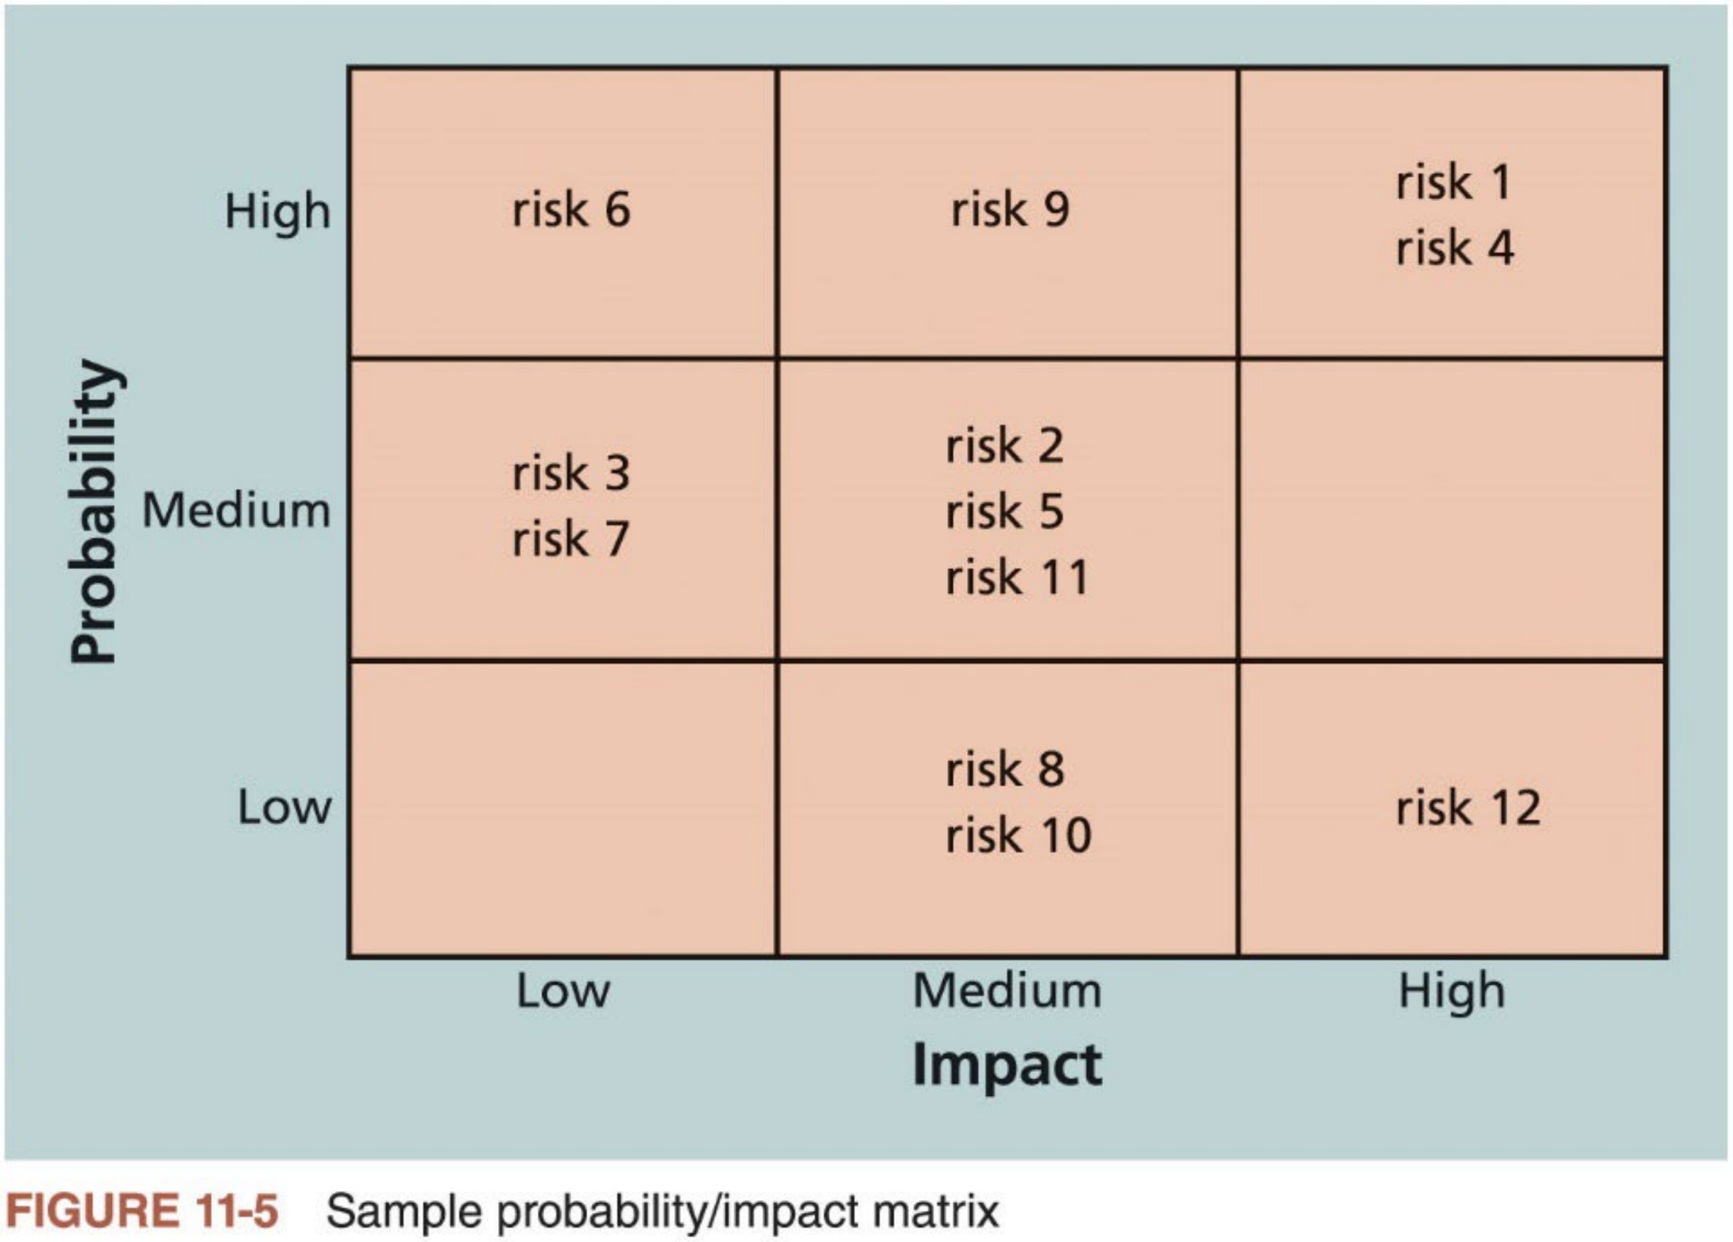
Probability/Impact Matrixes (2 of 3)
27

Slide 27
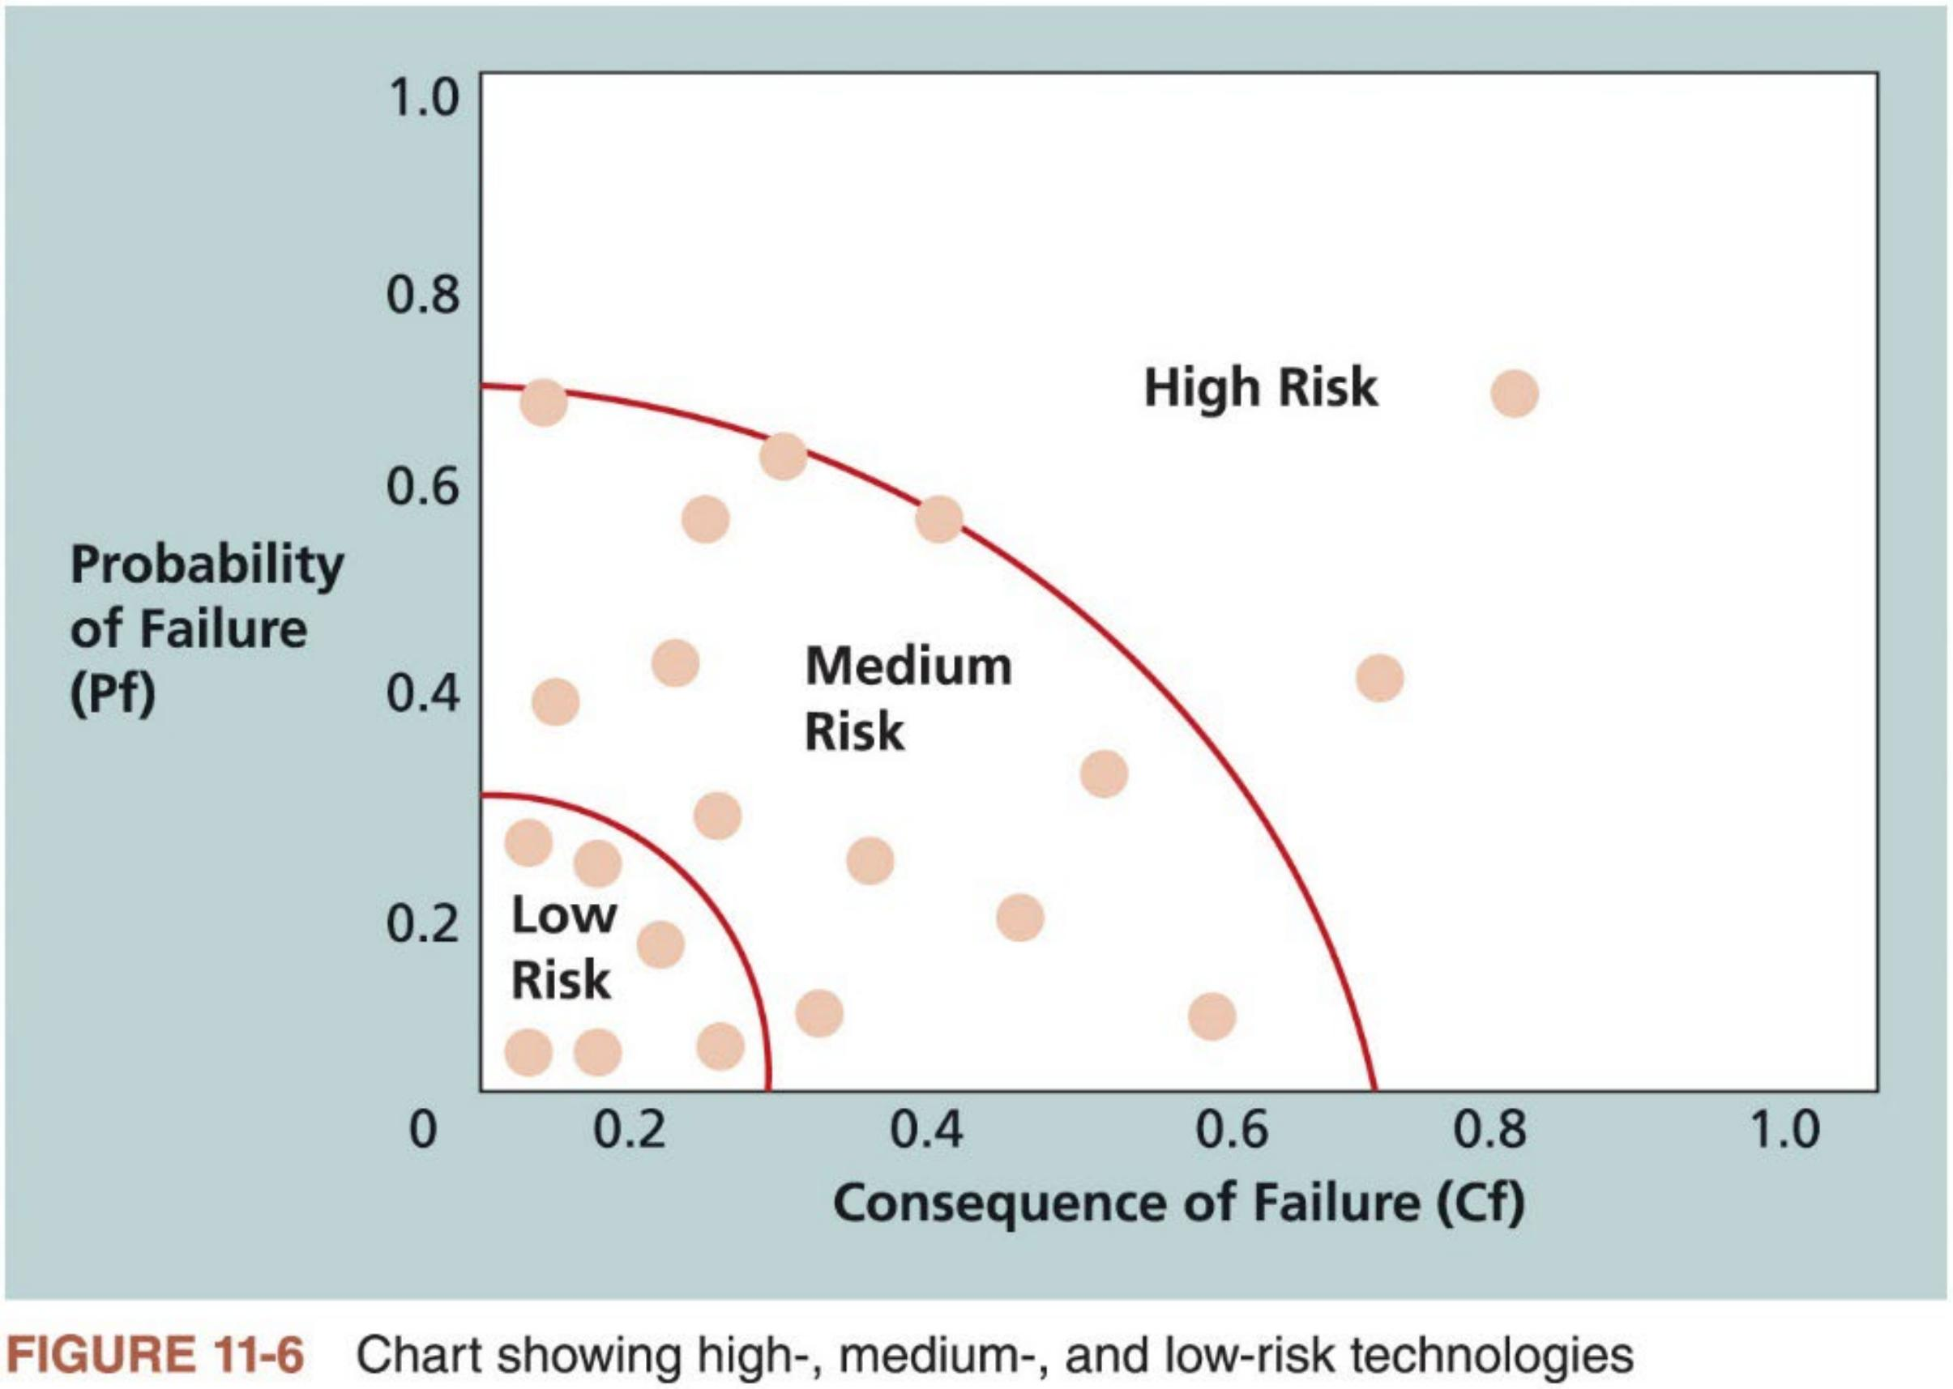
Probability/Impact Matrixes (3 of 3)
28

Slide 28

Top Ten Risk Item Tracking (1 of 2)
n A qualitative risk analysis tool that helps identify and monitor risks throughout the life of a project
It establishes a periodic review of the top ten project risk items with management. Similar reviews can also occur with the customer.
The review includes the current ranking, previous ranking, number of times the risk appears on the list over a time period, and a summary ofprogress
made in resolving the risk item since the previous review.
n Goals of risk management review
1. Keep management and customer (if included) aware of major influences that could prevent or enhance the project’s success;
2. By involving the customer, the project team may be able to consider alternative strategies for addressing the risks;
3. Promote confidence in the project team by demonstrating to management and the customer that the team is aware of significant risks, has a strategy in place, and is effectively carrying out that strategy.
29

Slide 29
Top Ten Risk Item Tracking (2 of 2)
n Table 11-5 provides a sample Top Ten Risk Item Tracking chart that could be used at a management review meeting for a project
Monthly Ranking
Risk Event | Rank This Month | Rank Last Month | Number of Months in Top Ten | Risk Resolution Progress
Inadequate planning | 1 | 2 | 4 | Working on revising the entire project management plan
Poor definition | 2 | 3 | 3 | Holding meetings with project customer and sponsor to clarify scope
Absence of leadership | 3 | 1 | 2 | Assigned a new project manager to lead the project after the previous one quit
Poor cost estimates | 4 | 4 | 3 | Revising cost estimates
Poor time estimates | 5 | 5 | 3 | Revising schedule estimates
Table 11-5 Example of top ten risk item tracking
30

Slide 30
4. Perform Quantitative Risk Analysis
n Often follow qualitative risk analysis, yet both can be done together or separately
n The nature of the project and availability of time and money affect which risk analysis techniques are used
On some projects, the team may only perform qualitative risk analysis.
Large, complex projects involving leading edge technologies often require extensive quantitative risk analysis
n Quantitative risk analysis techniques
1. Decision tree analysis
2. Simulation
3. Sensitivity analysis
31

Slide 31



Decision Trees Analysis (1 of 4)
n A decision tree is a diagramming analysis technique used to help select the best course of action when future outcomes are uncertain.
It is a graphical and chronological representation of a decision problem, consisting of the following elements:
: decision node
● : probability node
: end node (often omitted)
: branches leaving decision node represent the different decisions
: branches leaving probability node represent the different-outcomes
32

Slide 32
Decision Trees Analysis (2 of 4)
1. Decision trees are composed of nodes (circles, squares, and triangles) and branches (lines)
2. The nodes represent points in time. There are three types of nodes: 1) decision node (a square), 2) probability node (a circle), and end node (a triangle)
3. Time proceeds from left to right
4. Branches leading out of a decision (resp., probability) node represent the possible decisions (resp., outcomes of uncertain events); the
decision maker can choose the preferred branch (respectively, cannot control which of these to occur)
5. Probabilities are listed on probability branches, and conditional on the events that have already been observed. The sum of probabilities on
branches out of any probability node must be equal to 1
6. Monetary values are shown to the right of the end nodes
33

Slide 33
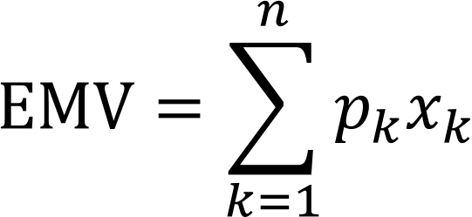
Decision Trees Analysis (3 of 4)
n Expected Monetary Value (EMV) for a decision is a weighted average of the possible payoffs for this decision, weighted by the probabilities of the outcomes
Suppose that one decision leads to in total n different monetary outcomes, x₁, x_{2,} … , x_{n,} with corresponding probabilities p_{1,} p_{2,} …, p_{n}. Then, EMV for this decision is given by
n Decision trees provide a folding-back procedure to systematically calculate EMVs and identify the optimal decision strategy
Starting from the right of the decision tree and working back to the left: 1. At each probability node, calculate an EMV – a sum of products of monetary values and probabilities. 2. At each decision node, take a maximum of EMVs to identify the optimal decision.
34

Slide 34
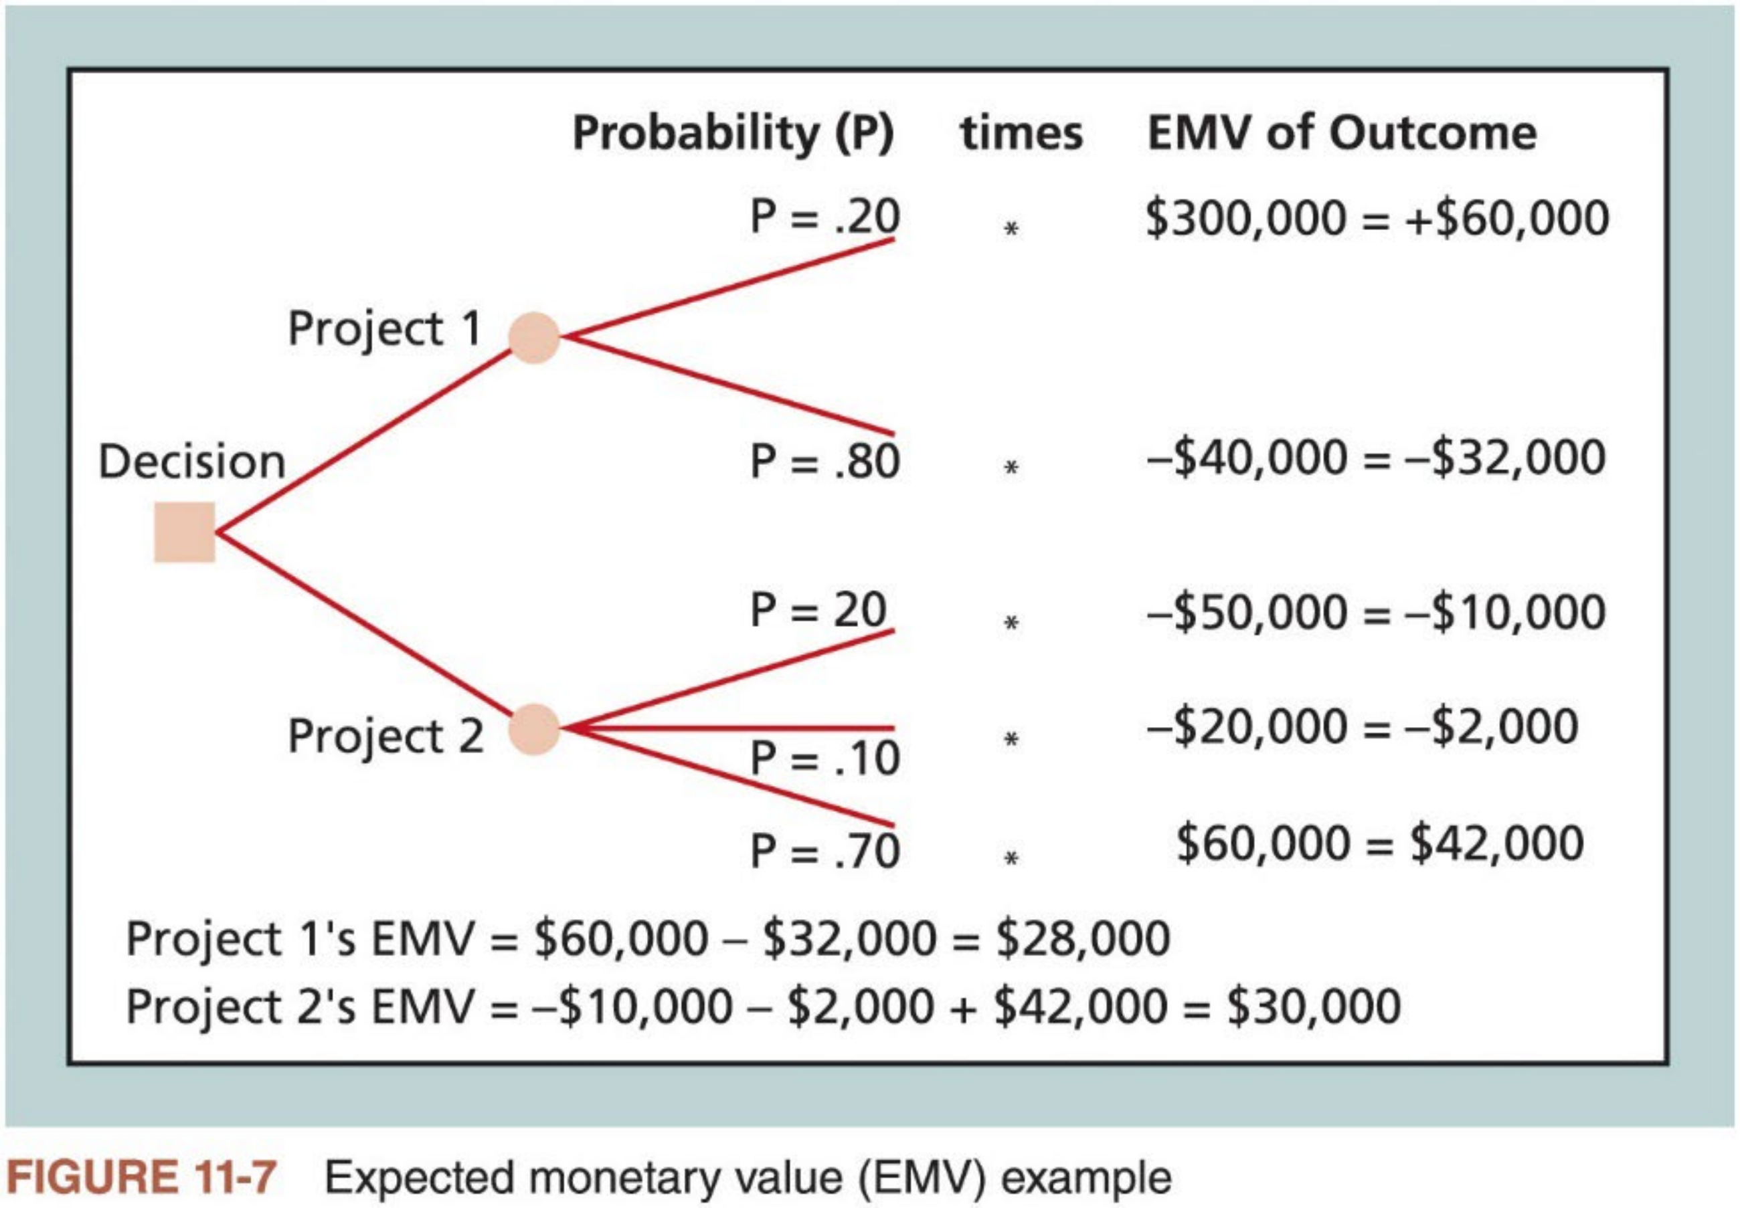
Decision Trees Analysis (4 of 4)
35

Slide 35
Simulation (1 of 3)
n Simulation builds a model ofa system to analyze the expected behavior or performance of the system
Most simulations are based on some form of Monte Carlo analysis
n Monte Carlo analysis simulates a model’s outcome many times to provide a statistical distribution of the calculated results
It can predict the probability of finishing by a certain date or the probability that the cost will be equal to or less than a certain value.
n Different distribution functions can be used for performing Monte Carlo analysis
A common distribution is three-point estimate (most likely, pessimistic, and optimistic estimates) (refer to PERT in Lecture 4 and three-point cost
estimates in Lecture 5)
36

Slide 36
Simulation (2 of 3)
n Five steps of Monte Carlo analysis using three-point estimates
1. Collect the most likely, optimistic, and pessimistic estimates for the random variables in the model;
2. Determine the probability distribution of each variable;
3. For each variable, select a random value based on its probability distribution;
4. Run a deterministic analysis or one pass through the model using the combination of values selected for each of the variables;
5. Repeat Steps 3 and 4 many times (e.g., 5,000) to obtain the probability distribution of the model’s results.
n Figure 11-8 illustrates the results from a Monte Carlo-based simulation of a project schedule
“Number of samples” is the number of times repeating Steps 3 and 4
The histogram displays frequencies of completing the project on different days; the table (S-shape curve) shows the (cumulative) probabilities
37

Slide 37
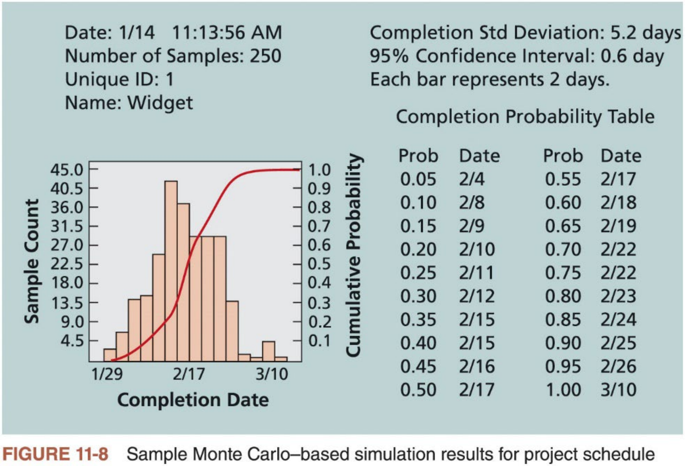
Simulation (3 of 3)
38

Slide 38
Sensitivity Analysis (1 of 2)
n Sensitivity analysis (or what-if analysis) shows the effects of changing one or more variables on an outcome
For example, many people use it to determine what the monthly payments for a loan will be given different interest rates or periods ofthe loan
n Spreadsheet software, such as Microsoft Excel, is a common tool for performing sensitivity analysis
Figure 11-9 shows an example Excel file created to show the break-even point for a product based on three inputs
n Important Excel functions for what-if analysis
Goal Seek: find the input value to produce a desired output value according to a formular.
Data Table: create one- or two-variable data table to quickly try out different input values to produce output values according to formulas
39

Slide 39
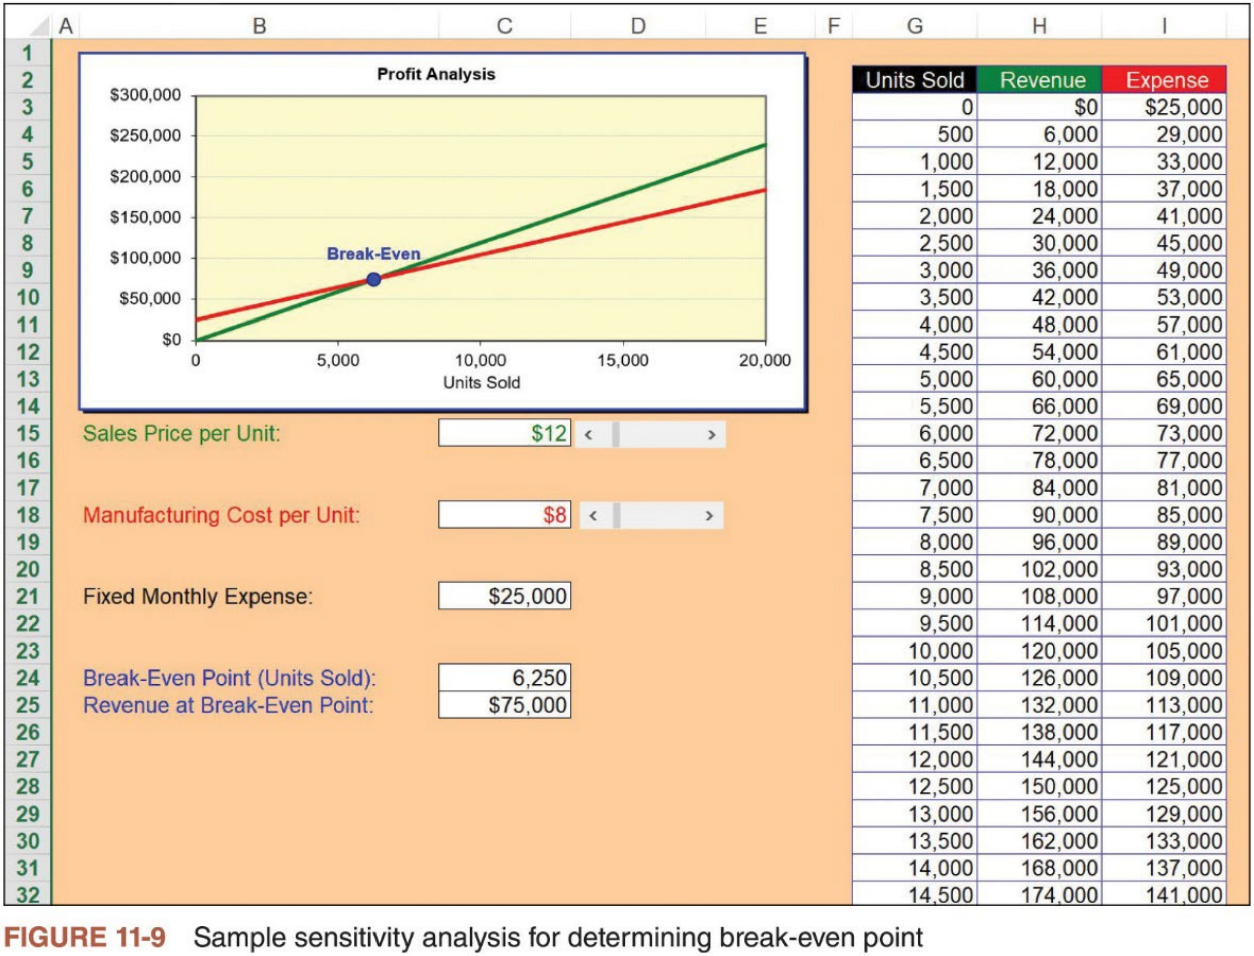
Sensitivity Analysis (2 of 2)
40

Slide 40
5. Plan Risk Responses (1 of 4)
n An organization must develop an appropriate response to risks after they are identified and quantified
It involves developing options and defining strategies for reducing negative risks and enhancing positive risks
n Five basic response strategies for negative risks
1. Risk avoidance: eliminate a specific threat, usually by eliminating its causes. Not all risks can be eliminated, but specific risk events can be.
2. Risk acceptance: accept the consequences ifa risk occurs.
3. Risk transference: shift the consequence of a risk and responsibility for its management to a third party.
4. Risk mitigation: reduce the impact of a risk event by reducing the probability and impact of its occurrence.
5. Risk escalation: notify a higher-level authority within the organization.
41

Slide 41
5. Plan Risk Responses (2 of 4)
n Table 11-6 provides general mitigation strategies for technical, cost, and schedule risks on projects
Technical Risks | Cost Risks | Schedule Risks
Emphasize team support and avoid stand-alone project structure |  | Increase the frequency of project monitoring
 | Use WBS and CPM | Use WBS and CPM
Improve problem handling and communication | Improve communication, understanding of project goals, and team support
Increase the frequency of project monitoring | Increase project manager authority
Use WBS and CPM
Increase the frequency of project monitoring
Increase project manager authority
Select the most experienced project manager
Table 11-6 General risk mitigation strategies for technical, cost, and schedule risks
42

Slide 42
5. Plan Risk Responses (3 of 4)
n Five basic response strategies for positive risks (opportunities)
1. Risk exploitation: do whatever you can to make sure the positive risk occurs.
2. Risk sharing: share the ownership of the risk with another party.
3. Risk enhancement: change the size of the opportunity by identifying and maximizing key drivers of the positive risk.
4. Risk acceptance also applies to positive risks when the project team does not take any actions toward a risk.
5. Risk escalation: notify a higher-level authority.
n Main outputs: updates to the P.M. plan and other project documents and change requests
For example, the P.M. plan, WBS, and project schedule need to be updated if the risk response strategies require additional tasks, resources, or time to accomplish.
43

Slide 43

5. Plan Risk Responses (4 of 4)
n Risk response strategies also provide updated information for the risk register by describing the risk responses, risk owners, and status
information
n Often include identification of residual and secondary risks, as well as contingency plans and reserves
Residual risks (残余风险) are risks that remain after all the response
strategies have been implemented. For example, even though a stable
hardware product may have been used on a project, there may still be a risk that it fails to function properly.
Secondary risks (次生风险) are direct result of implementing a risk response. For example, using the more stable hardware may have caused a risk of
peripheral devices failing to function properly.
44

Slide 44


6. Implement Risk Responses
n Implementing risk responses, as defined in planning risk responses, is the main executing process in project risk management
n Key outputs
Change requests
Project documents updates (e.g., issue log, lessons-learned register, project team assignments, risk register, and risk report)
For example, Cliff’s team had identified the risk event of having a new customer. They listed several activities they could perform to help manage this risk, such as making sure the project manager took the time to understand the customer, setting up a meeting to get to know the customer and clarify expectations, and having Cliff attend the meeting. In this case, Cliff’s team was proactive in identifying this risk and would take actions to prevent any negative events from happening by implementing their risk responses.
45

Slide 45
7. Monitor Risks
n Monitoring risks involves
i. ensuring the appropriate risk responses are performed
ii. tracking identified risks
iii. identifying and analyzing new risks, and
iv. evaluating effectiveness of risk management throughout the project
n Project risk management does not stop with the initial risk analysis
A redistribution of resources devoted to risk management may be necessary because of relative changes in risk exposure
Carrying out individual risk management plans involves monitoring risks based on defined milestones and making decisions regarding risks and their response strategies
n Outputs include work performance information, change requests, updates to the P.M. plan, project documents, and organizational process assets
46

Slide 46

Use Software to Assist in Project Risk Management
n A variety of software can assist in various risk management processes
Risk registers can be created in a Microsoft Word or Excel file or as part ofa sophisticated database
Spreadsheets can aid in tracking and quantifying risks, preparing charts and graphs, and performing sensitivity analysis
Software such as PrecisionTree helps create decision trees and estimate the EMV
Simulation software such as @Risk helps develop simulation models to analyze and respond to various risks
n Project teams must be careful not to rely too heavily on software when performing project risk management
If a risk is not identified, it cannot be managed. Intelligent and experienced people are needed to identify risks.
It takes hard work to develop and implement good risk response strategies.
47

Slide 47


Case Wrap-Up
Cliff Branch and two of his senior people attended a seminar on project risk management where
the speaker discussed several techniques, such as estimating the EMVs of projects and Monte
Carlo simulations. Cliff asked the speaker how these techniques could help his company decide
which projects to bid on, because bidding on projects often required up-front investments with the possibility of no payback. The speaker walked through an example of EMV and then ran a quick Monte Carlo simulation. Cliff did not have a strong math background and had a hard time
understanding the EMV calculations. He thought the simulation was much too confusing to have any practical use for him. He believed in his gut instincts much more than any math calculation or computer output.
The speaker finally sensed that Cliff was not impressed, so she explained the importance of
looking at the odds of winning project awards and not just at the potential profits. She suggested
using a risk-neutral strategy by bidding on projects that the company had a good chance of winning (50 percent or so) and that had a good profit potential, instead of focusing on projects that they had a small chance of winning and that had a larger profit potential. Cliff disagreed with this advice,
and he continued to bid on high-risk projects.
The two other managers who attended the seminar now understood why the firm was having
problems – their leader loved taking risks, even if it hurt the company. They soon found jobs with competing companies, as did several other employees.
48

Slide 48
Complementary Reading
n Chapter 11 “Project Risk Management” of Schwalbe (2018)
n Chapter 11 “Project Risk Management” in Part 1 of PMBOK® Guide (2017)
49

